Slide 1
E-ATTENDANCE SYSTEM
-- BY
ADHIKARI.SAIKIRAN – 20BCS6088
KAVURI.VANDHAN MURALI- 20BCS6001
DWAPOYAN ROY – 20BCS6043
RUNJHUN MATHUR – 20BCS6071

Slide 2
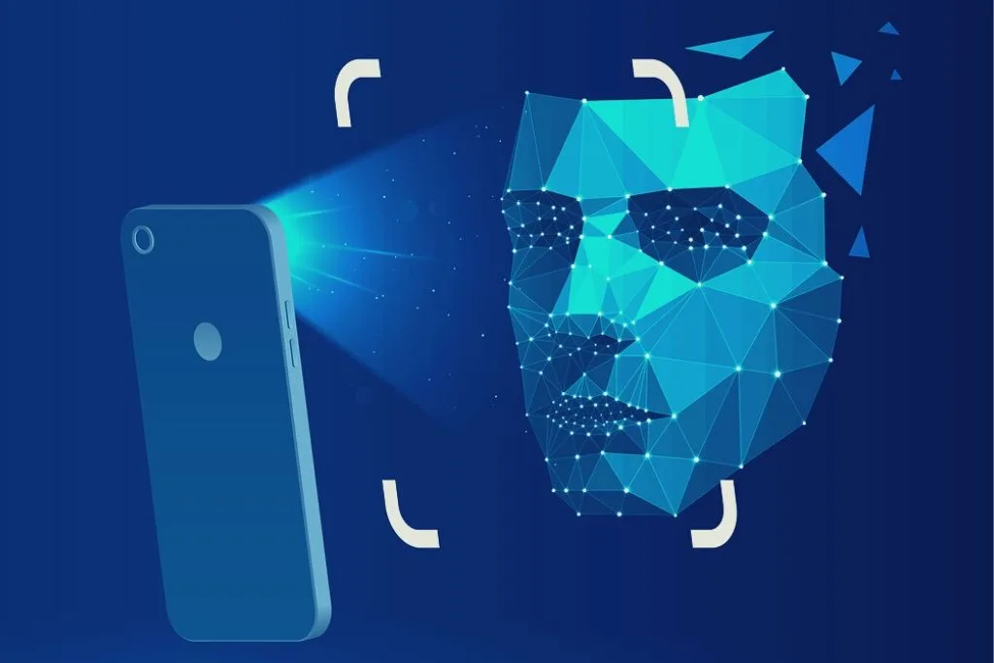
What is E-Attendance system?
Attendance management system” is software developed for maintaining the attendance of the student on the daily basis in the collage.
An accurate report based on the student attendance is generated here.
This system will also help in evaluating attendance eligibility criteria of a student.
Report of the student’s attendance on weekly and monthly basis is generated.

Slide 3
FEATURES:
Easy to use with interactive GUI support.
Password protection for new person registration.
Creates/updates csv file for deatils of students on registration.
Creates a new csv file everyday for attendance and marks attendance with proper date and time.

Slide 4



SOFTWARES USED :
Tkinter for the GUI
Opencv for face recognition
(cv2.Face.Lbphfacerecognizer)
CSV, numpy, pandas, datetime etc. For other purposes.

Slide 5
SPECIFICATIONS
1. Uses LBPH (Local Binary Pattern Histogram) algorithm for face recognization.
2. Score of minimum 100 required to perfectly match a face.
3. Metric : Camera Resolution
4. As prototype, it is fixed to 15 users only but scalable design
5. Requires good lightning condition for better camera capture ability
6. Attendance sheet is .csv file format and can be digitally distributed and maintained.

Slide 6
OPENCV
OpenCV is a great tool for image processing and performing computer vision tasks.
It is an open-source library that can be used to perform tasks like face detection, objection tracking, landmark detection, and much more.
OpenCV supports a wide variety of programming languages like Python, C++, Java, etc.

Slide 7
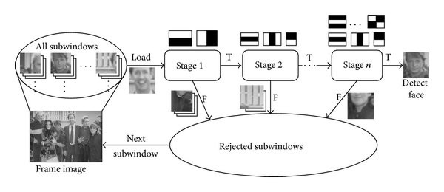
HAAR-CASCADE CLASSIFIER
It is an Object Detection Algorithm used to identify faces in an image or a real time video.

Slide 8
LBPH ALGORITHM
LBPH (Local Binary Pattern Histogram) is a Face-Recognition algorithm it is used to recognize the face of a person.
LBPH is one of the easiest face recognition algorithms.
It can represent local features in the images.
It is possible to get great results (mainly in a controlled environment).
It is robust against monotonic gray scale transformations.
It is provided by the OpenCV library (Open Source Computer Vision Library).

Slide 9
ADVANTAGES OF E-ATTENDANCE SYSTEM
Collect and store data automatically
Serve as a helping hand to administrative tasks
Helps to eliminate errors caused by humans
Possible to update and maintain attendance records
Saves money by improving employee performance and productivity
Shows accurate timings
Simple to operate

Slide 10
DIS-ADVANTAGES OF E-ATTENDANCE SYSTEM
Not effective in monitoring buddy punching
Increased equipment expense
Difficult to maintain and repair
System is ineffective if there is no power supply

Slide 11
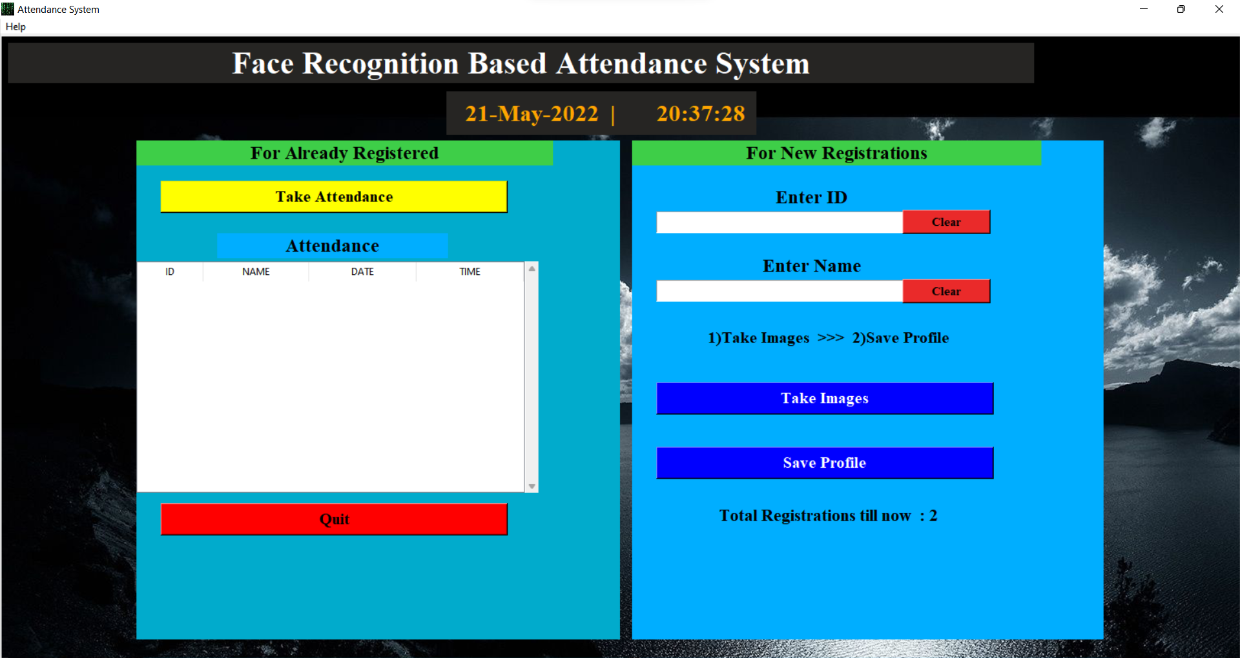
OUTPUT

Slide 12
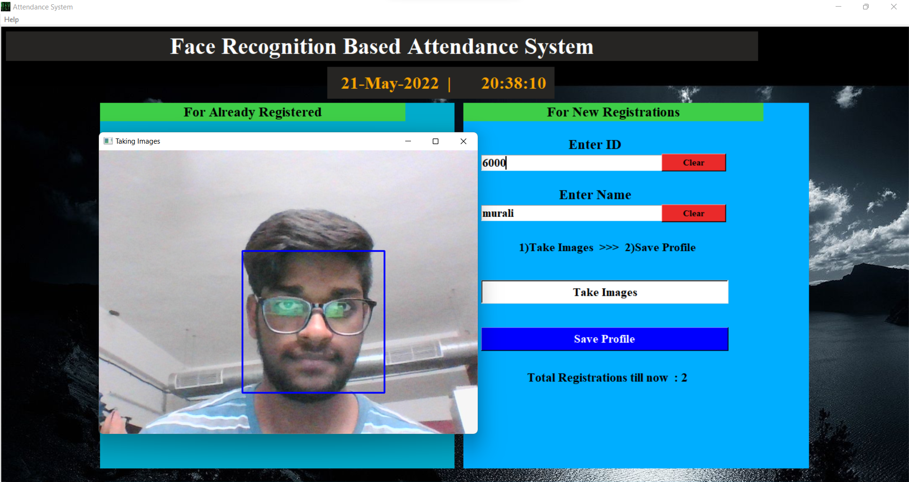

Slide 13
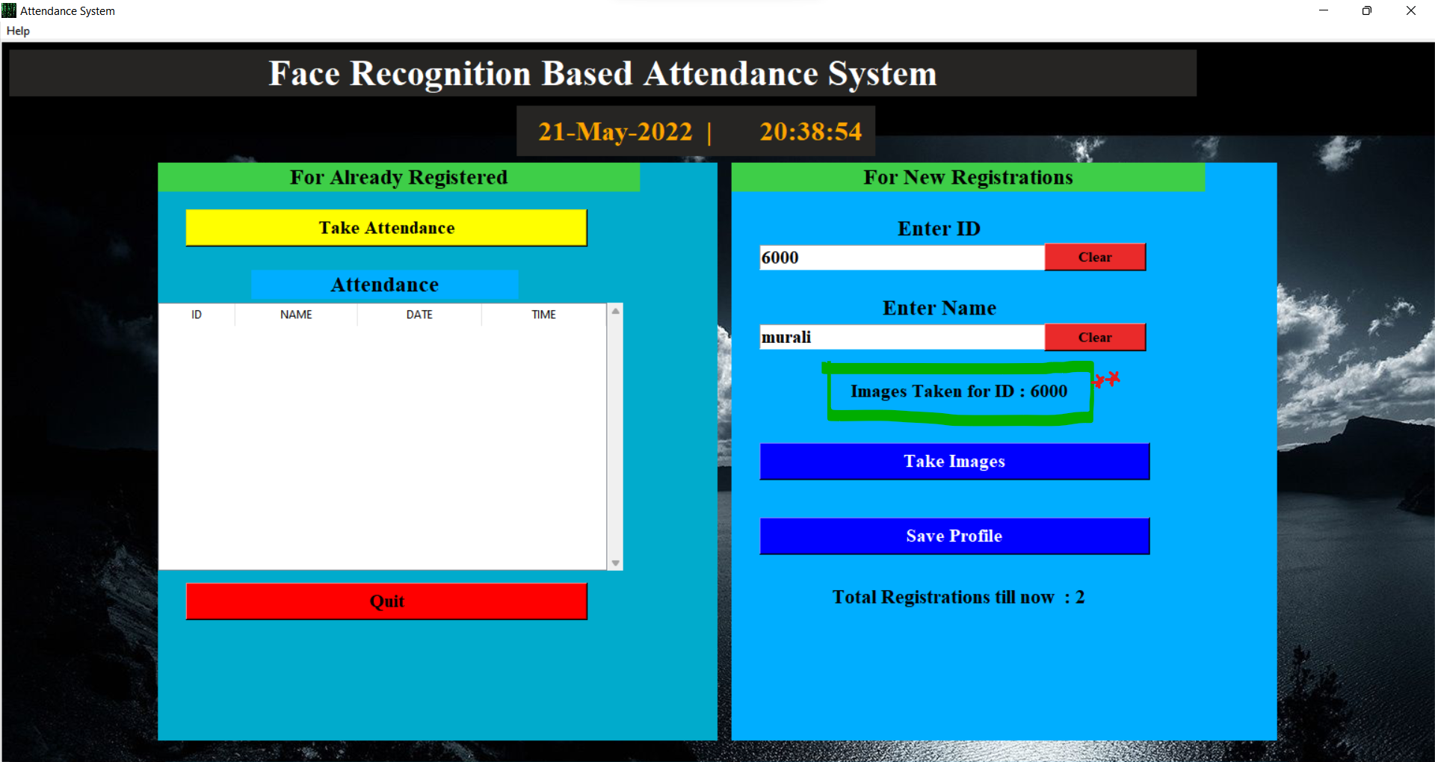

Slide 14
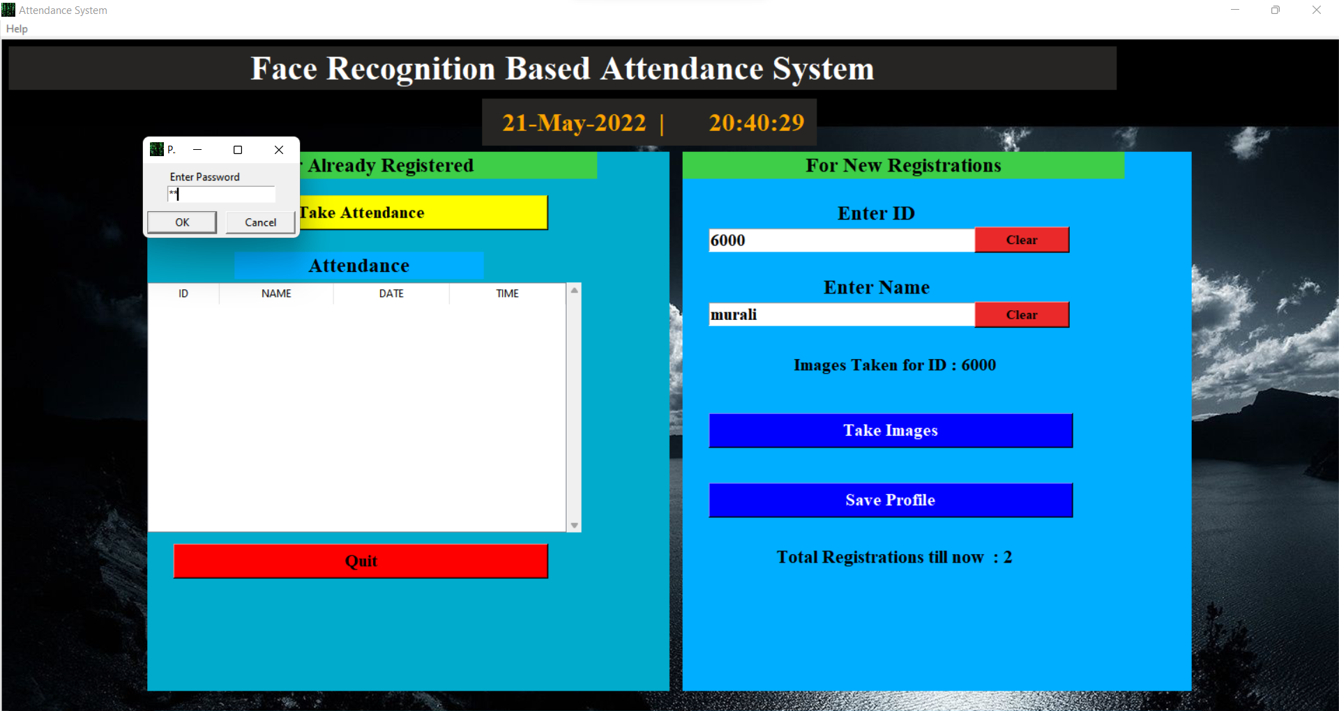

Slide 15
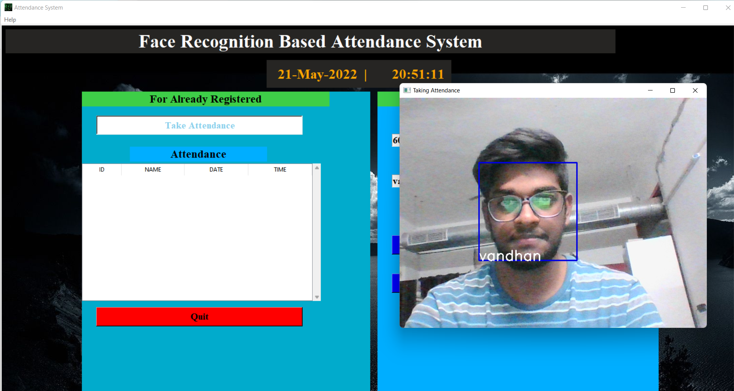

Slide 16
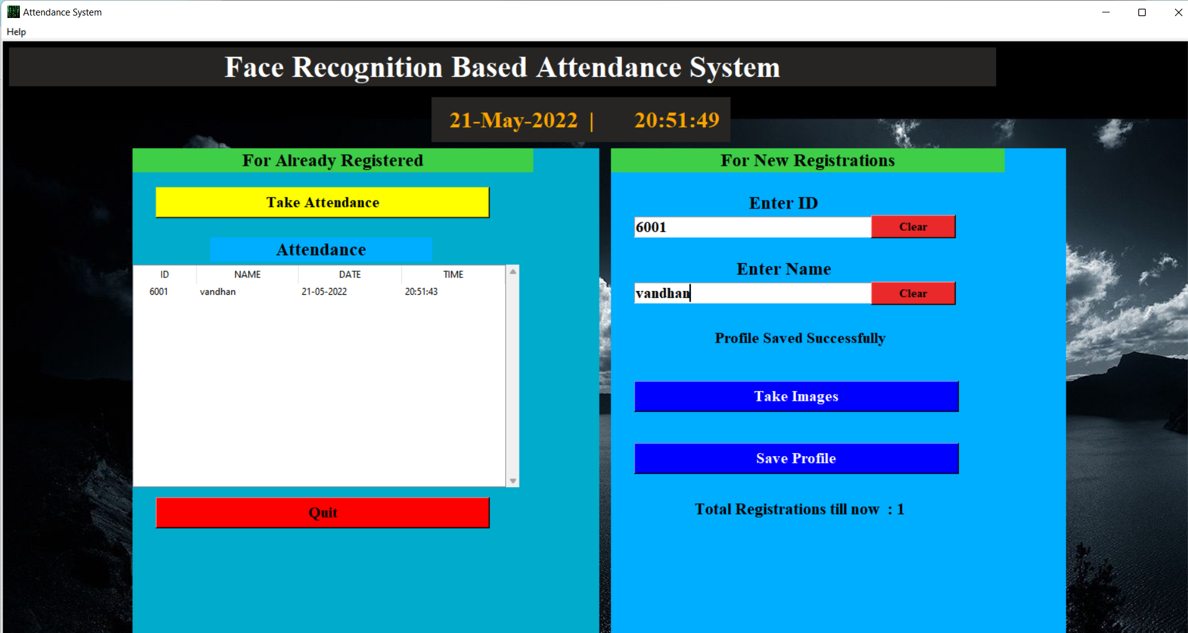

Slide 17
REFERENCE
https://www.analyticsvidhya.com/blog/2021/07/understanding-face-recognition-using-lbph-algorithm/#:~:text=LBPH%20
https://iq.opengenus.org/lbph-algorithm-for-face-recognition/
https://iq.opengenus.org/lbph-algorithm-for-face-recognition/
https://en.wikipedia.org/wiki/Facial_recognition_system
https://docs.opencv.org/3.4/db/d28/tutorial_cascade_classifier.html

Slide 18


